Slide 1
Process Synchronization-2 Synchronization Tools and Examples

Slide 2
Review： Critical-Section Problem
What is a critical-section?
What requirements should a solution to the critical-section problem satisfy?
What is a semaphore? How can you use the semaphore?

Slide 3
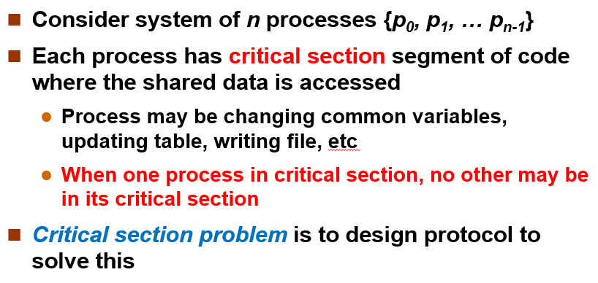
Review： Critical-Section Problem
What is a critical-section?
What requirements should a solution to the critical-section problem satisfy?
What is a semaphore? How can you use the semaphore?

Slide 4
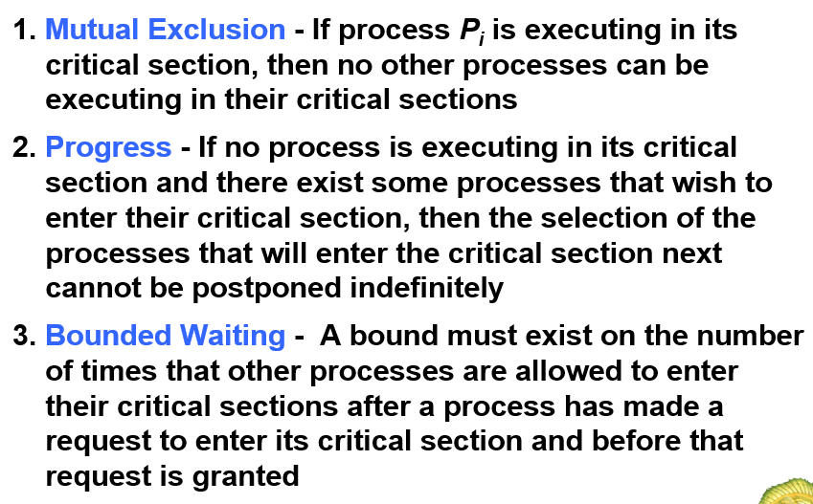
Review： Critical-Section Problem
What is a critical-section?
What requirements should a solution to the critical-section problem satisfy?
What is a semaphore? How can you use the semaphore?

Slide 5
Review： Critical-Section Problem
What is a critical-section?
What requirements should a solution to the critical-section problem satisfy?
What is a semaphore? How can you use the semaphore?
  A semaphore is an integer variable, can only accessed via two indivisible operations, wait and signal.
    wait(s) means request a resource
    signal(s) means release a resource

Slide 6
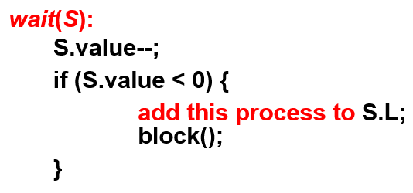
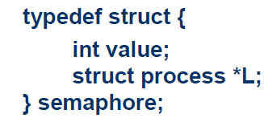
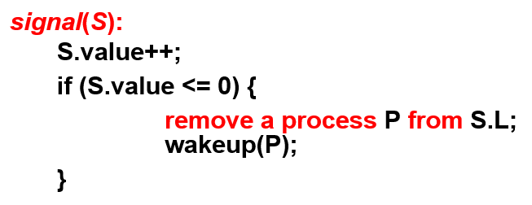
Review： Critical-Section Problem
To avoid busy waiting, we add a queue of process to semaphores, and define two other operations in wait and signal to block and wakeup processes.
Notes:
一个进程阻塞且等待信号量S，可以在其他进程执行signal操作之后被重新执行。该进程的重新执行是通过wakeup操作来进行的，该操作将进程从等待状态切换到就绪状态。接着，该进程被放入到就绪队列中。

Slide 7
Bounded-Buffer Problem
This is the same producer / consumer problem as before. But now we'll do it with signals and waits.

Slide 8
Problems with Semaphores
Correct use of semaphore operations:
  signal (mutex) …. wait (mutex)
  wait (mutex) … wait (mutex)
  Omitting of wait (mutex) or signal (mutex) (or both)
Notes:
虽然信号量提供了一种方便且有效的机制以处理进程同步，但是其不正确的使用仍然会导致一些定时同步错误并难以检测。

Slide 9
Today’s topic
Synchronization Software components
  Mutex Locks
  Semaphores
  Monitors
Classical Synchronization Issues
  Bounded-Buffer Problem
  Readers and Writers Problem
  Dining-Philosophers Problem
Liveness

Slide 10
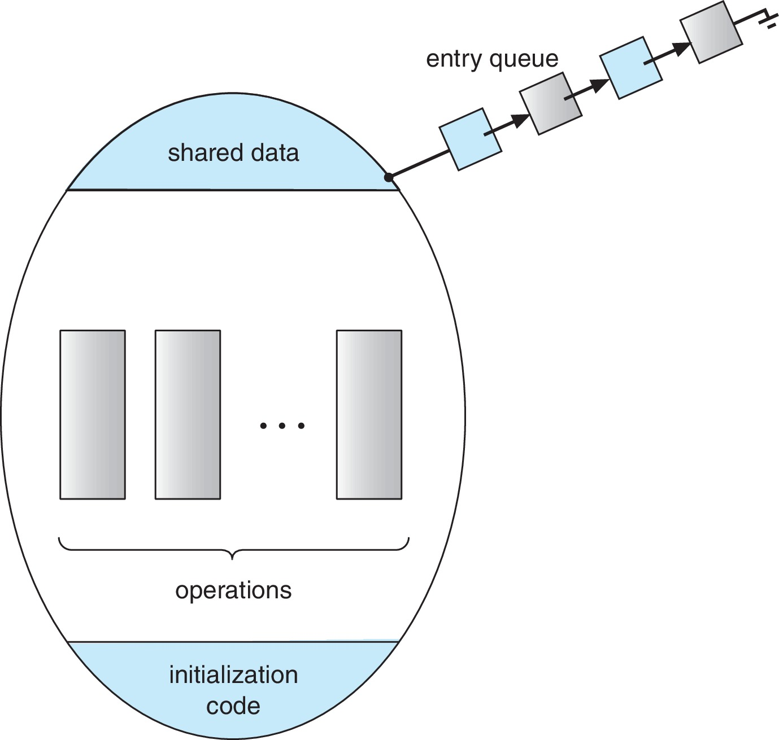
Monitors
A high-level abstraction that provides a convenient and effective mechanism for process synchronization.
Abstract data type, internal variables only accessible by code within the procedure
Schematic view of a Monitor:
Only one process may be active within the monitor at a time！

Slide 11
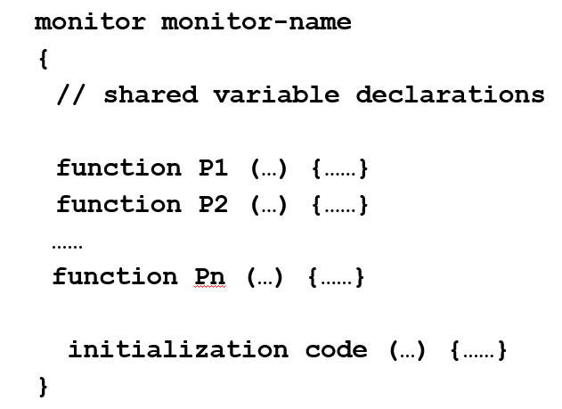
Monitors
Pseudocode syntax of a monitor:
It can ensure mutual exclusion, but is it able to support synchronization?

Slide 12
Condition Variables
To allow a process to wait within the monitor, a condition variable must be declared.
  condition x, y;
Two operations are allowed on a condition variable:
  x.wait() – a process that invokes the operation is suspended until x.signal()
  x.signal() – resumes one of processes (if any) that invoked x.wait()
    If no x.wait() on the variable, then it has no effect on the variable

Slide 13
Bounded-Buffer Problem Solved by Monitors

Slide 14
Kernel Synchronization
Windows uses interrupt masks to protect access to global resources on uniprocessor systems
  Uses spinlocks on multiprocessor systems
  Provides dispatcher objects user-land which may act mutexes, semaphores, events, and timers
Linux provides Semaphores, atomic integers, spinlocks, and reader-writer versions of both

Slide 15
Today’s topic
Synchronization Software components
  Mutex Locks
  Semaphores
  Monitors
Classical Synchronization Issues
  Bounded-Buffer Problem
  Readers and Writers Problem
  Dining-Philosophers Problem
Liveness

Slide 16

Readers-Writers Problem
A data set is shared among a number of concurrent processes
  Readers – only read the data set; they do not perform any updates
  Writers – can both read and write
Problem – allow multiple readers to read at the same time, but only one single writer can access the shared data at the same time.

Slide 17
Readers-writers problem
Notes:
读者优先，即一旦有读者开始读数据，后续的所有读者都将占有数据访问权，直到最后一个读者离开。而写者则可能被饿死。

Slide 18
Readers-Writers Problem
Several variations of how readers and writers are considered – all involve some form of priorities
  First variation – no reader kept waiting unless writer has permission to use shared object
  Second variation – once writer is ready, it performs the write ASAP
Both may have starvation leading to even more variations
Problem is solved on some systems by kernel providing reader-writer locks

Slide 19

Dining-Philosophers Problem
Philosophers spend their lives alternating thinking and eating
  Don’t interact with their neighbors, occasionally try to pick up 2 chopsticks (one at a time) to eat from bowl
  Need both to eat, then release both when done
In the case of 5 philosophers
  Shared data
    Bowl of rice (data set)
    Semaphore chopstick [5] initialized to 1

Slide 20
Solution 1 – Using Semaphore
The structure of Philosopher i:
    while (true){
    wait (chopstick[i] );
    wait (chopStick[ (i + 1) % 5] );
    /* eat for awhile */
    signal (chopstick[i] );
    signal (chopstick[ (i + 1) % 5] );
    /* think for awhile */
    }
What is the problem with this algorithm?
Deadlock!

Slide 21
Solution 2 –
Using monitor

Slide 22
Today’s topic
Synchronization Software components
  Mutex Locks
  Semaphores
  Monitors
Classical Synchronization Issues
  Bounded-Buffer Problem
  Readers and Writers Problem
  Dining-Philosophers Problem
Liveness

Slide 23
Liveness
Processes may have to wait indefinitely while trying to acquire a synchronization tool such as a mutex lock or semaphore.
  Waiting indefinitely violates the progress and bounded-waiting criteria discussed at the beginning of this chapter.
Liveness refers to a set of properties that a system must satisfy to ensure processes make progress.
  Indefinite waiting is an example of a liveness failure.
Deadlock – two or more processes are waiting indefinitely for an event that can be caused by only one of the waiting processes

Slide 24
Liveness
Let S and Q be two semaphores initialized to 1
P₀ P₁
wait(S); wait(Q);
wait(Q); wait(S);
... ...
signal(S); signal(Q);
signal(Q); signal(S);
Consider if P₀ executes wait(S) and P₁ wait(Q). When P₀ executes wait(Q), it must wait until P₁ executes signal(Q)
However, P₁ is waiting until P₀ execute signal(S).
Since these signal() operations will never be executed, P₀ and P₁ are deadlocked.

Slide 25
Liveness
Other forms of deadlock:
  Starvation – indefinite blocking
    A process may never be removed from the semaphore queue in which it is suspended
  Priority Inversion – Scheduling problem when lower-priority process holds a lock needed by higher-priority process

Slide 26
Appendix: Java Synchronization
Java provides rich set of synchronization features:
  Java monitors
  Reentrant locks
  Semaphores
  Condition variables

Slide 27
Java Monitors
Every Java object has associated with it a single lock.
If a method is declared as synchronized, a calling thread must own the lock for the object.
If the lock is owned by another thread, the calling thread must wait for the lock until it is released.
Locks are released when the owning thread exits the synchronized method.

Slide 28
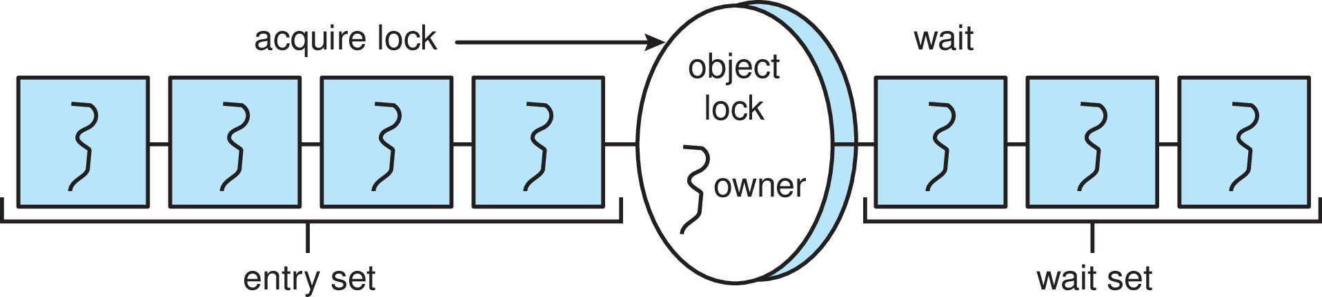
Java Synchronization
A thread that tries to acquire an unavailable lock is placed in the object’s entry set:
Similarly, each object also has a wait set.
When a thread calls wait():
  It releases the lock for the object
  The state of the thread is set to blocked
  The thread is placed in the wait set for the object

Slide 29
Java Synchronization
A thread typically calls wait() when it is waiting for a condition to become true.
How does a thread get notified?
When a thread calls notify():
  An arbitrary thread T is selected from the wait set
  T is moved from the wait set to the entry set
  Set the state of T from blocked to runnable.
T can now compete for the lock to check if the condition it was waiting for is now true.

Slide 30
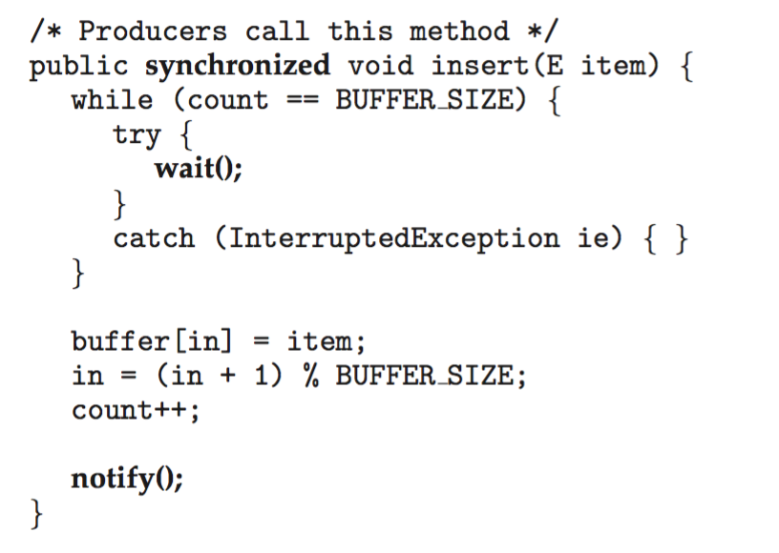
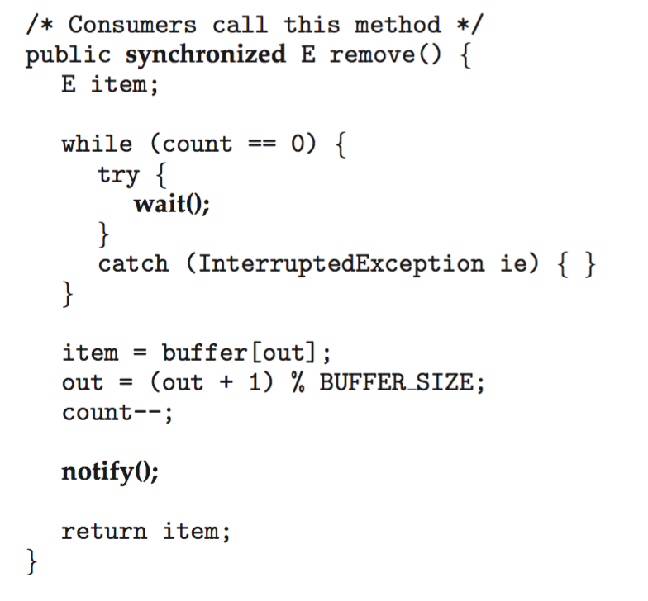
Bounded Buffer – Java Synchronization

Slide 31
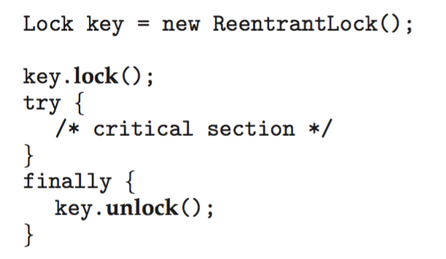
Java Reentrant Locks
Similar to mutex locks
The finally clause ensures the lock will be released in case an exception occurs in the try block.

Slide 32

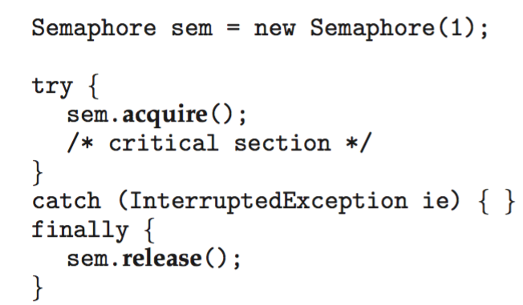
Java Semaphores
Constructor:
Usage:

Slide 33

Java Condition Variables
Condition variables are associated with an ReentrantLock.
Creating a condition variable using newCondition() method of ReentrantLock:
A thread waits by calling the await() method, and signals by calling the signal() method.

Slide 34
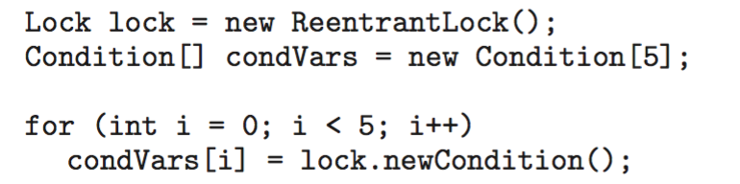
Java Condition Variables
Example: Five threads numbered 0 .. 4
  Shared variable turn indicating which thread’s turn it is.
  Thread calls doWork() when it wishes to do some work. (But it may only do work if it is their turn.）
  If not their turn, wait
  If their turn, do some work for awhile …...
  When completed, notify the thread whose turn is next.
  Necessary data structures:

Slide 35
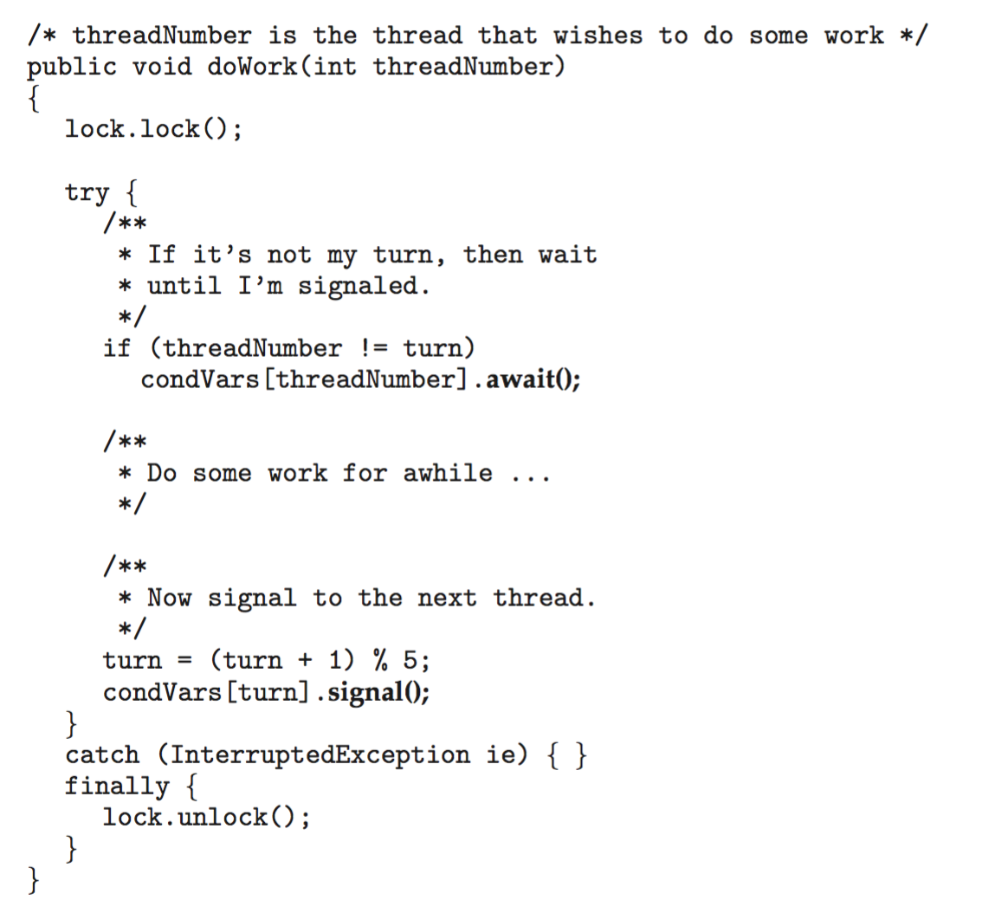
Java Condition Variables

Slide 36
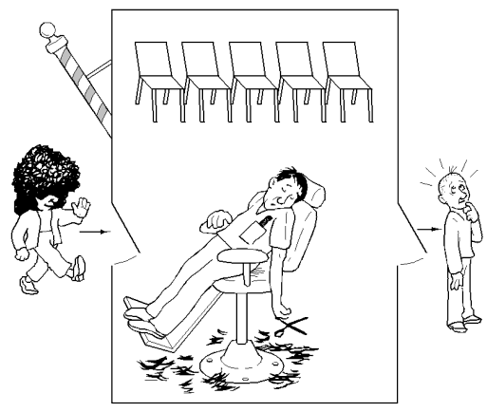
Discussion
The Sleeping-Barber Problem:
  A barbershop consists of a waiting room with n chairs and the barber room containing the barber chair.
  If there are no customers to be served, the barber goes to sleep.
  If a customer enters the barbershop and all chairs are occupied, then the customer leaves the shop.
  If the barber is busy but chairs are available, then the customer sits in one of the free chairs.
  If the barber is asleep, the customer wakes up the barber.
Notes:
http://blog.csdn.net/new_town/article/details/1465629

Slide 37
Process Synchronization-2 Synchronization Tools and Examples

